Slide 1
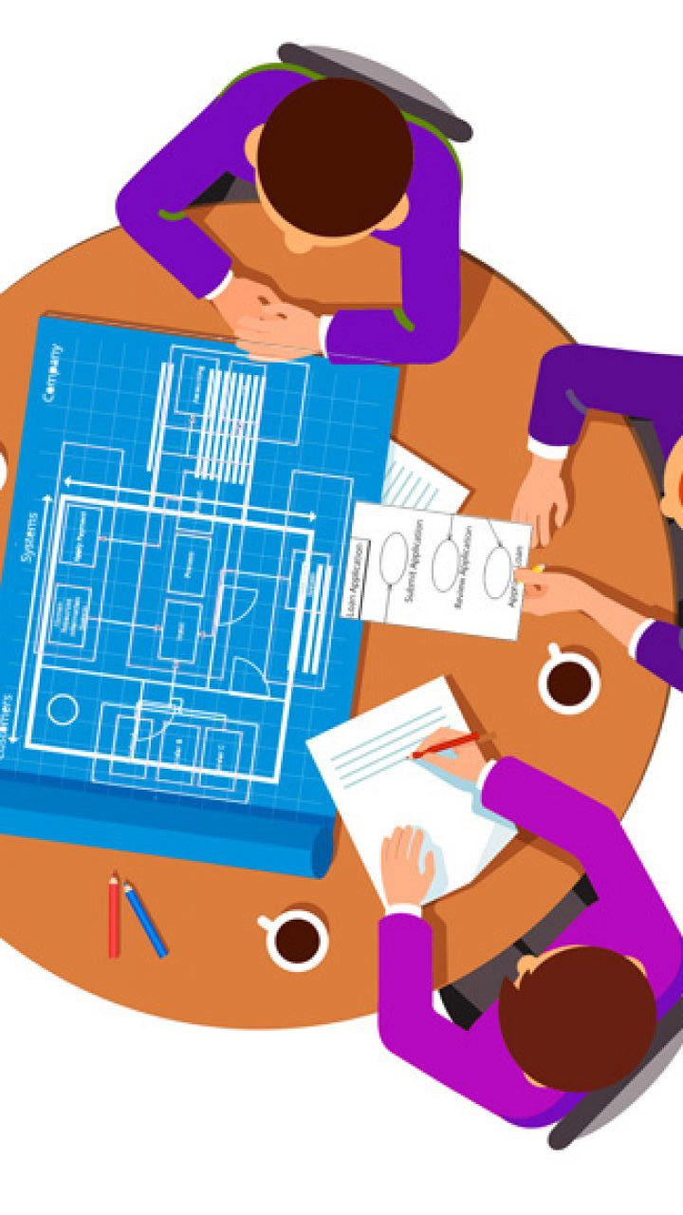
System Analysis Stage
Requirement Gathering

Slide 2
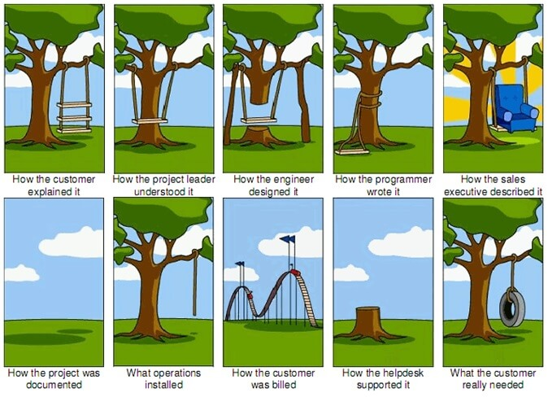
What happens if you skip gathering requirements for your software project?
Depending on your project methodology, you may do this step at the beginning during a Discovery phase, you may do it during the project within each sprint or build cycle, or you may skip it altogether and hope for the best. That last option is a simple way to sabotage your project and guarantee a lot of late nights and awkward status meetings.

Slide 3
Outline
Introduction
Stakeholder analysis
Artefact-driven elicitation techniques
Background study
Questionnaires
Storyboards
Scenarios
Stakeholder-driven elicitation techniques
Interviews
Observation & ethnographic studies
Requirements validation
Requirements Prioritization

Slide 4
Requirements engineering
The process of establishing the services that the customer requires from a system and the constraints under which it operates and is developed.
The requirements themselves are the descriptions of the system services and constraints that are generated during the requirements engineering process.

Slide 5
What is a requirement?
It may range from a high-level abstract statement of a service or of a system constraint to a detailed mathematical functional specification.
This is inevitable as requirements may serve a dual function
May be the basis for a bid for a contract - therefore must be open to interpretation;
May be the basis for the contract itself - therefore must be defined in detail;
Both these statements may be called requirements.

Slide 6
Requirements abstraction
“If a company wishes to let a contract for a large software development project, it must define its needs in a sufficiently abstract way that a solution is not pre-defined. The requirements must be written so that several contractors can bid for the contract, offering, perhaps, different ways of meeting the client organization’s needs. Once a contract has been awarded, the contractor must write a system definition for the client in more detail so that the client understands and can validate what the software will do. Both of these documents may be called the requirements document for the system.”

Slide 7
Requirements specification
The process of writing down the user and system requirements in a requirements document.
User requirements have to be understandable by end-users and customers who do not have a technical background.
System requirements are more detailed requirements and may include more technical information.
The requirements may be part of a contract for the system development
It is therefore important that these are as complete as possible.

Slide 8
Ways of writing a system requirements specification
Notation | Description
Natural language | The requirements are written using numbered sentences in natural language. Each sentence should express one requirement.
Structured natural language | The requirements are written in natural language on a standard form or template. Each field provides information about an aspect of the requirement.
Design description languages | This approach uses a language like a programming language, but with more abstract features to specify the requirements by defining an operational model of the system. This approach is now rarely used although it can be useful for interface specifications.
Graphical notations | Graphical models, supplemented by text annotations, are used to define the functional requirements for the system; UML use case and sequence diagrams are commonly used.
Mathematical specifications | These notations are based on mathematical concepts such as finite-state machines or sets. Although these unambiguous specifications can reduce the ambiguity in a requirements document, most customers don’t understand a formal specification. They cannot check that it represents what they want and are reluctant to accept it as a system contract

Slide 9
Types of requirement
User requirements
Statements in natural language plus diagrams of the services the system provides and its operational constraints. Written for customers.
System requirements
A structured document setting out detailed descriptions of the system’s functions, services and operational constraints. Defines what should be implemented so may be part of a contract between client and contractor.

Slide 10
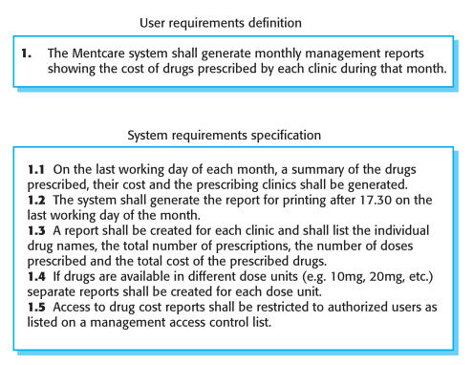
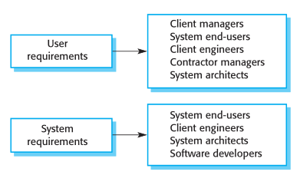
User and system requirements
Readers of different types of requirements specification

Slide 11
Functional and non-functional requirements
Functional requirements
Statements of services the system should provide, how the system should react to particular inputs and how the system should behave in particular situations.
May state what the system should not do.
Non-functional requirements
Constraints on the services or functions offered by the system such as timing constraints, constraints on the development process, standards, etc.
Often apply to the system as a whole rather than individual features or services.
Domain requirements
Constraints on the system from the domain of operation

Slide 12
Functional requirements
Describe functionality or system services.
Depend on the type of software, expected users and the type of system where the software is used.
Functional user requirements may be high-level statements of what the system should do.
Functional system requirements should describe the system services in detail.

Slide 13
Functional requirement examples for a Mental Care System
A user shall be able to search the appointments lists for all clinics.
The system shall generate each day, for each clinic, a list of patients who are expected to attend appointments that day.
Each staff member using the system shall be uniquely identified by his or her 8-digit employee number.

Slide 14
Non-functional requirements
These define system properties and constraints e.g. reliability, response time and storage requirements. Constraints are I/O device capability, system representations, etc.
Process requirements may also be specified mandating a particular IDE, programming language or development method.
Non-functional requirements may be more critical than functional requirements. If these are not met, the system may be useless.

Slide 15
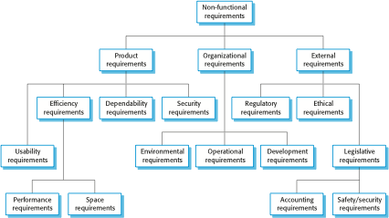
Types of non-functional requirement

Slide 16
Non-functional requirements implementation
Non-functional requirements may affect the overall architecture of a system rather than the individual components.
For example, to ensure that performance requirements are met, you may have to organize the system to minimize communications between components.
A single non-functional requirement, such as a security requirement, may generate a number of related functional requirements that define system services that are required.
It may also generate requirements that restrict existing requirements.

Slide 17
Outline
Introduction
Stakeholder analysis
Artefact-driven elicitation techniques
Background study
Questionnaires
Storyboards
Scenarios
Stakeholder-driven elicitation techniques
Interviews
Observation & ethnographic studies
Requirements validation
Requirements Prioritization

Slide 18
Stakeholder analysis
Stakeholder cooperation is essential for successful req. gathering
Elicitation = cooperative learning
Representative sample must be selected to ensure adequate, comprehensive coverage of the problem world
dynamic selection as new knowledge is acquired
Selection based on ...
relevant position in the organization
role in making decisions, reaching agreement
type of contributed knowledge, level of domain expertise
exposure to perceived problems
personal interests, potential conflicts
influence in system acceptance
Knowledge acquisition from stakeholders is difficult: Distributed sources, Different background, Personnel turnover.

Slide 19
Background study
Collect, read, synthesize documents about...
the organization: organizational charts, business plans, financial reports, meeting minutes, etc
the domain: books, surveys, articles, regulations, reports on similar systems in the same domain
the system-as-is: documented workflows, procedures, business rules; exchanged documents; defect/complaint reports, change requests, etc.
Provides basics for getting prepared before meeting stakeholders => prerequisite to other techniques
The current system is called the as-is system
The new system is called the to-be system

Slide 20
Questionnaires
Submit a list of questions to selected stakeholders, each with a list of possible answers (+ brief context if needed)
Multiple choice question: one answer to be selected from answer list
Weighting question: list of statements to be weighted...
qualitatively (‘high’, ‘low”, ...), or
quantitatively (percentages)
to express perceived importance, preference, risk etc.
Effective for acquiring subjective info quickly, cheaply, remotely from many people
Helpful for preparing better focused interviews (see next)

Slide 21
Questionnaires should be carefully prepared
Subject to ...
multiple biases: recipients, respondents, questions, answers
unreliable info: misinterpretation of questions, of answers, inconsistent answers, ....
=> Guidelines for questionnaire design/validation:
Select a representative, statistically significant sample of people; provide motivation for responding
Check coverage of questions, of possible answers
Make sure questions, answers, formulations are unbiased & unambiguous
Add implicitly redundant questions to detect inconsistent answers
Have your questionnaire checked by a third party

Slide 22
Storyboards
Goal: acquire or validate info from concrete examples through narratives ...
how things are running in the system-as-is
how things should be running in the system-to-be
Storyboard: tells a story by a sequence of snapshots
Snapshot = sentence, sketch, slide, picture, etc.
Possibly structured with annotations:
WHO are the players, WHAT happens to them, WHY this happens, WHAT IF this does / does not happen, etc
Passive mode (for validation): stakeholders are told the story
Active mode (for joint exploration): stakeholders contribute

Slide 23
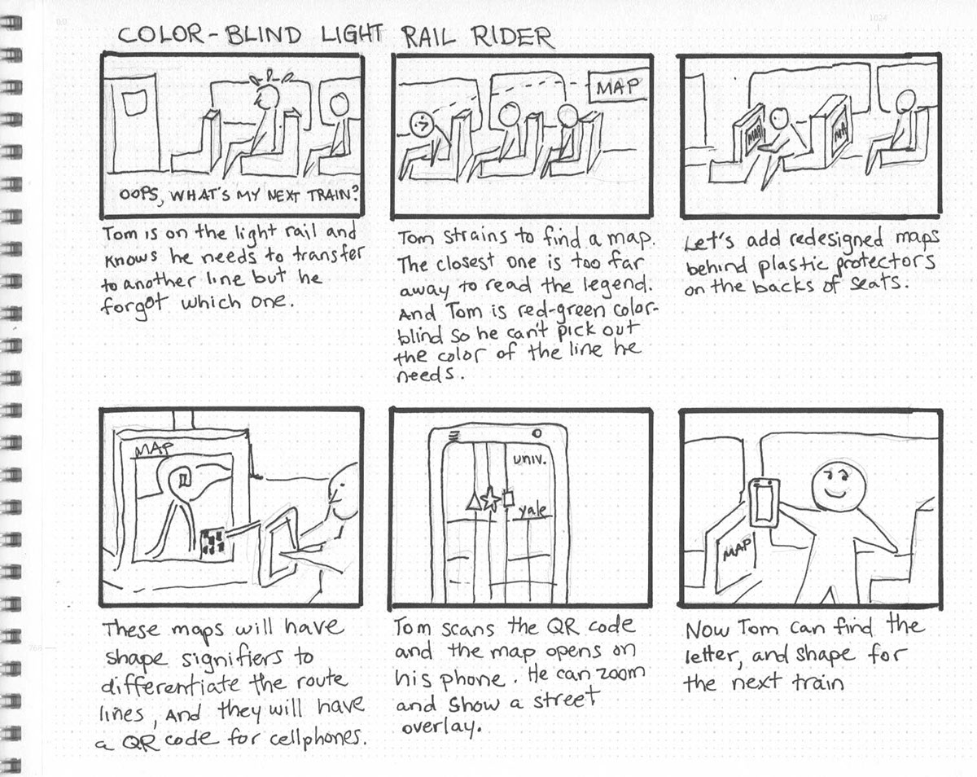
Storyboards: Color Blind Example

Slide 24
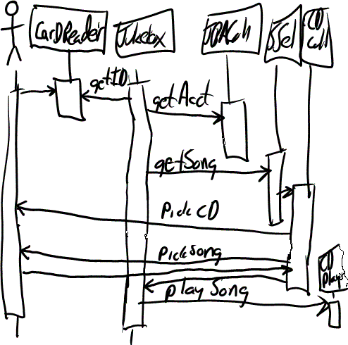
Scenarios
Illustrate typical sequences of interaction among system components to meet an implicit objective
Widely used for...
explanation of system-as-is
exploration of system-to-be + elicitation of further info ...
e.g. WHY this interaction sequence ?
WHY among these components ?
specification of acceptance test cases
Represented by text or diagram

Slide 25
Types of scenario
Positive scenario = one behavior the system should cover (example)
Negative scenario = one behavior the system should exclude (counter-example)
Normal scenario: everything proceeds as expected
Abnormal scenario = a desired interaction sequence in exception situation (still positive)
e.g. meeting initiator not authorized
participant constraints not valid

Slide 26
Scenarios: pros & cons
J Concrete examples/counter-examples
J Narrative style (appealing to stakeholders)
J Yield animation sequences, acceptance test cases
L Inherently partial (cf. test coverage problem)
L Combinatorial explosion (cf. program traces)
L Potential overspecification: unnecessary sequencing,
premature software-environment boundary
L May contain irrelevant details,
incompatible granularities from different stakeholders
L Keep properties about the system implicit
cf. confidentiality req in negative scenario example
Concrete scenarios naturally jump in anyway...
invaluable as initial elicitation vehicles
Notes:
Implicit properties: They capture interaction sequences, but not the reasons why such sequences should or should not take place;

Slide 27
Outline
Introduction
Stakeholder analysis
Artefact-driven elicitation techniques
Background study
Questionnaires
Storyboards
Scenarios
Stakeholder-driven elicitation techniques
Interviews
Observation & ethnographic studies
Requirements validation
Requirements Prioritization

Slide 28
Interviews
Primary technique for knowledge elicitation
1. Select stakeholder specifically for info to be acquired
(domain expert, manager, salesperson, end-user, consultant, ...)
2. Organize meeting with interviewee, ask questions, record answers
3. Write report from interview transcripts
4. Submit report to interviewee for validation & refinement
Single interview may involve multiple stakeholders
J saves times
L weaker contact; individuals less involved, speak less freely
Interview effectiveness (measured as weighted ratio):
(utility x coverage of acquired info) / time needed

Slide 29
Types of interview
Structured interview: predetermined set of questions
specific to purpose of interview
some open-ended, others with pre-determined answer set
=> more focused discussion, no rambling among topics
Unstructured interview: no predetermined set of questions
free discussion about system-as-is, perceived problems, proposed solutions
=> exploration of possibly overlooked issues
=> Effective interviews should mix both modes ...
start with structured parts
shift to unstructured parts as felt necessary

Slide 30
Interviews: strengths & difficulties
J May reveal info not acquired through other techniques
how things are running really, personal complaints, suggestions for improvement, ...
J On-the-fly acquisition of info appearing relevant
new questions triggered from previous answers
L Acquired info might be subjective (hard to assess)
L Potential inconsistencies between different interviewees
L Effectiveness critically relies on interviewer’s attitude, appropriateness of questions
=> Interviewing guidelines

Slide 31
Guidelines for effective interviews
Identify the right interviewee sample for full coverage of issues
different responsibilities, expertise, tasks, exposure to problems
Come prepared, to focus on right issue at right time
backgound study first
predesign a sequence of questions for this interviewee
Centre the interview on the interviewee’s work & concerns
Keep control over the interview
Make the interviewee feel comfortable
Start: break ice, provide motivation, ask easy questions
Consider the person too, not only the role
Do always appear as a trustworthy partner
Be focused, open-minded flexible in case of unexpected answers
keep open-ended questions for the end
Ask why-questions without being offending
Edit & structure interview transcripts while still fresh in mind
Keep interviewee in the loop

Slide 32
Observation & ethnographic studies
Focus on task elicitation in the system-as-is
Understanding a task is often easier by observing people performing it (rather than verbal or textual explanation)
cf. tying shoelaces
Passive observation: no interference with task performers
Watch from outside, record (notes, video), edit transcripts, interpret
Protocol analysis: task performers concurrently explain it
Ethnographic studies: over long periods of time, try to discover emergent properties of social group involved
about task performance + attitudes, reactions, gestures, ...
Active observation: you get involved in the task, even become a team member

Slide 33
Observation & ethnographic studies: pros & cons
J May reveal ...
Tacit(implicit) knowledge that would not emerge otherwise
e.g. ethnographic study of air traffic control => implicit mental
model of air traffic to be preserved in system-to-be
hidden problems through tricky ways of doing things
culture-specific aspects to be taken into account
J Contextualization of acquired info
L Slow & expensive: to be done over long periods of time, at different times, under different workload conditions
L Potentially inaccurate (people behave differently when observed)
L Data mining problem, interpretation problem
L Focus on system-as-is

Slide 34
Outline
Introduction
Stakeholder analysis
Artefact-driven elicitation techniques
Background study
Questionnaires
Storyboards
Scenarios
Stakeholder-driven elicitation techniques
Interviews
Observation & ethnographic studies
Requirements validation
Requirements Prioritization

Slide 35
Requirements Validation
Concerned with demonstrating that the requirements define the system that the customer really wants.
Requirements error costs are high so validation is very important
Fixing a requirements error after delivery may cost up to 100 times the cost of fixing an implementation error.
Requirements checking, includes:
Validity. Does the system provide the functions which best support the customer’s needs?
Consistency. Are there any requirements conflicts?
Completeness. Are all functions required by the customer included?
Realism. Can the requirements be implemented given available budget and technology
Verifiability. Can the requirements be checked?

Slide 36
Requirements validation techniques
Requirements reviews
Systematic manual analysis of the requirements.
Verifiability: Is the requirement realistically testable?
Comprehensibility: Is the requirement properly understood?
Traceability: Is the origin of the requirement clearly stated?
Adaptability: Can the requirement be changed without a large impact on other requirements?
Prototyping
Using an executable model of the system to check requirements.
Test-case generation
Developing tests for requirements to check testability.

Slide 37
Requirement Prioritization
Prioritization can be applied to requirements/User Stories, tasks, products, use cases, acceptance criteria and tests.
MoSCoW prioritization, also known as the MoSCoW method or MoSCoW analysis, is a popular prioritization technique for managing requirements.
The acronym MoSCoW represents four categories of initiatives:
Must-have:
Non-negotiable product needs that are mandatory for the team.
Should-have:
Important initiatives that are not vital but add significant value.
Could-have:
Nice to have initiatives that will have a small impact if left out.
Will not have right now:
Initiatives that are not priority for this specific time frame.
Categorizing a requirement as a Should Have or Could Have does not mean it won’t be delivered; simply that delivery is not guaranteed.

Slide 38
Must Have
These provide the Minimum Usable SubseT (MUST) of requirements which the project guarantees to deliver. These may be defined using some of the following:
No point in delivering on target date without this; if it were not delivered, there would be no point deploying the solution on the intended date
Not legal without it
Unsafe without it
Cannot deliver a viable solution without it
Ask the question ‘what happens if this requirement is not met?’ If the answer is ‘cancel the project – there is no point in implementing a solution that does not meet this requirement’, then it is a Must Have requirement.

Slide 39
Should & Could Have
Should Have requirements are defined as:
Important but not vital
May be painful to leave out, but the solution is still viable
May need some kind of workaround, e.g. management of expectations, some inefficiency, an existing solution, paperwork etc. The workaround may be just a temporary one
Could Have requirements are defined as:
Wanted or desirable but less important
Less impact if left out (compared with a Should Have)
One way of differentiating a Should Have requirement from a Could Have is by reviewing the degree of pain caused by the requirement not being met, measured in terms of business value or numbers of people affected.

Slide 40
Won’t Have this time
These are requirements which the project team has agreed will not be delivered (as part of this timeframe).
They are recorded in the Prioritized Requirements List where they help clarify the scope of the project.
This avoids them being informally reintroduced at a later date.
This also helps to manage expectations that some requirements will simply not make it into the Deployed Solution, at least not this time around

Slide 41
References
Requirements Engineering: From System Goals to UML Models to Software Specifications
https://www.productplan.com/glossary/moscow-prioritization
https://www.agilebusiness.org/dsdm-project-framework/moscow-prioririsation.html

